Slide 1
Project management lesson 02 – Leading projects reference: pmi.org – PMBOK 5th edition
HoGent Bedrijf en Organisatie
Guy Dekoning
Academiejaar 2016-2017

Slide 2
Part 3: Leading projects

Slide 3
What did we remember from the last lesson?
Scope
Triple constraints
Project phase? Which one?
Requirement phase
Concept phase
What is a PID?
…

Slide 4
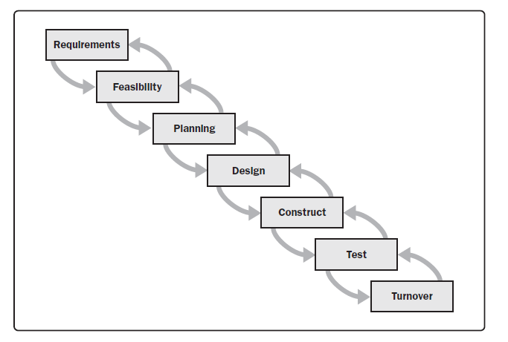
Recap ….
Project management is…
unique
iteration
lifecycle
Continue changes
metrics
Has an end …

Slide 5
Project phase 3- ‘the planning’ ⬅ Important
What is a ‘project planning’?… who do what, when and how?
Who ? Roles and Responsibilities = RACI-model
What ? What tasks should be done to accomplish the objectives
How will we estimate efforts?
Where? Location of the team(s) – location of the “Build” – Locations of the suppliers? etc …
How?
Sequential or parallel approach
Do we make use of intermediate evaluation gates
Agile?

Slide 6
Project phase 3- ‘the planning’ ⬅ Important
Search in …
Deliverables of the planning-phase:
Kick-off meeting → mostly forgotten --- very important to initiate a project
All stakeholders should be involved
Summary and recap of the project – The CONCEPT phase is the INPUT of the kick-off
In a kick-off project changes could occur.
The result = Projectplan
Slack-time vs critical path → pg 80-81
Slack-time = Slack or Float provide flexibility in the project schedule. When leveraged properly, project managers can shift activities and resources to meet the project objectives and priorities. It is the amount of time an activity can be delayed without impacting other activities or the project end date and changes over the course of the project implementation. Slack and float are the same thing. They can be used interchangeably, so our discussion of slack and float will purposely use both. Once the concept is understood, it is more important to understand how to leverage slack time within projects.
CPM (critcal path method) = the difference between the length of a path and the critical path. If an activity has zero slack, it is on the critical path
Search in …

Slide 7
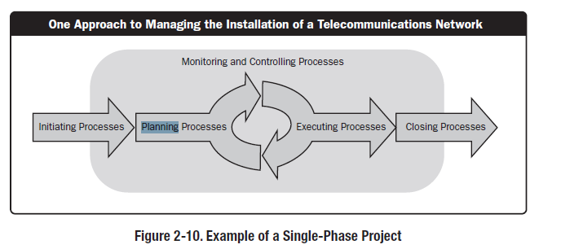
Single phase project (IPECC)

Slide 8
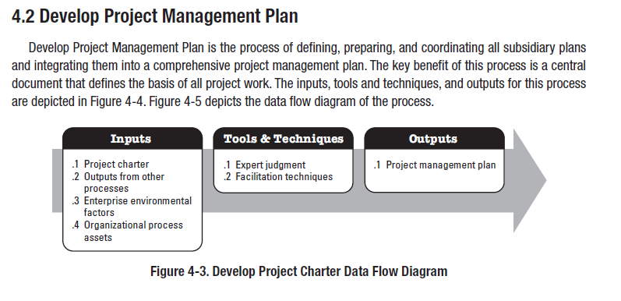
We NEED always a PLAN!.
To have a project PLAN we do need to plan it first – In the PID you’ll find the approach to create the project plan.

Slide 9
Planning documents

Slide 10
Project phase 3- ‘the planning’ ⬅ Important
Deliverables of the planning phase (project plan) – pg 77-81
WBS (work breakdown structure)
Hierarchical representation of all deliverables
Breakdown in theme’s or packages
WBS = input of the “ planning”
…
Project management is also part of the WBS.
Break down your project in the manageable parts (scope – performance – training – communication …)
Search in …

Slide 11
Project phase 3- ‘the planning’ ⬅ Important
Examples of a WBS

Slide 12
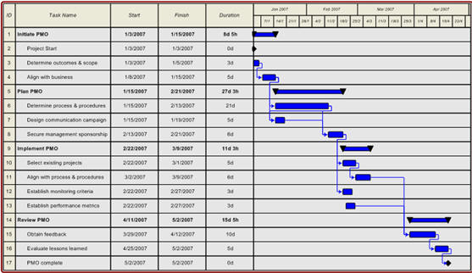
Project phase 3- ‘the planning’ ⬅ Important
Deliverables of the planning phase (project plan)– pg 77-81
GANTT
Sequence of activities are easy to read and understand…
Sequence changes are difficult because of their mutual interdependencies …..

Slide 13
Project phase 3- ‘the planning’ ⬅ Important
Criterions of a well defined project plan…: pg 152 - …
Scope definition– needed to define budget and time lines…
Translate the objectives in controls (=KPI) and also, if possibile finetune the objective description.
Risk management– The objectives of project risk management are to
increase the likelihood and impact of positive events, and decrease the likelihood and impact of negative events
in the project.;
Define Quality control-points – Involve all stakeholders to have a quality control concensus..
Deliverable: --- the projectplan!
Have a plan = first big step in having control points – measurement of progress - quaity – performance
No plan = BAD plan = increases the complexitity, means increase RISKs ….
Define and explain your tactical approach to reach the required objective(s)

Slide 15
Project phase 3- ‘the planning’ ⬅ Important
3 baselines to control
Scope
Time
Budget
Change of a baseline → change request
Look up ..…

Slide 16
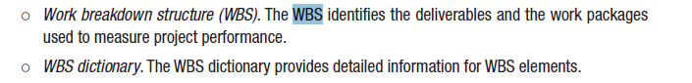
Project phase 3 - ‘planning’ project-baseline “SCOPE”
2 (two) type of scope:
Product scope – focus on requirements (see “process requirements”)
PBS (product breakdown structure) – aka BOM (“bill of materials”)
Project scope – which tasks builds up a project?
WBS (work breakdown structure)
E.g. = Financial
E.g. = Training of end users
E.g. = Testing
E.g = Risk management

Slide 17
Project phase 3 - ‘planning’ project-baseline “SCOPE”
3-builging blocks of the SCOPE-baseline:
Scope statement – pg 156
High-level statement describing the scope.
Describes the direction to take to reach the requested objectives
Describes the framework and method which will be used to manage the project
PBS and/or WBS– pg 157
See slide 16
WBS dictionary– pg 158
See next slide
Look up ..…

Slide 18
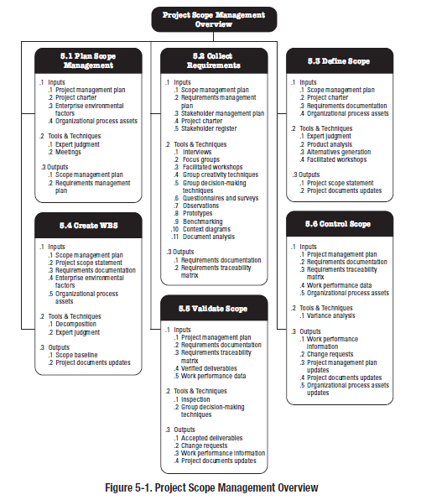

Slide 19
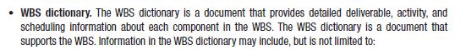
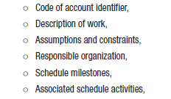
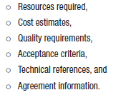
WBS dictionary

Slide 20
In which sequence? What’s the duration? – TIME
5 steps
1. Activities – 2. Sequence – 3. Resources – 4. Duration – 5. Timeline

Slide 21
Project phase 3- ‘planning’ - project-baseline “TIME”
Basis = scope baseline (pg 160) consists of a Project scope statement – WBS and WBS-dictionary
5 Steps to determine the timeline
Activity dictionary / inventory
Define the logical sequence and dependencies
Set-up PDM (precedence diagramming-method (pg 163)
FS – finish to start
FF – finish to finish
SS – start to start
SF – start to finish
Determine all type of resources + make estimations of efforts
Determine and estimate duration of efforts
Build-up your time lines taking into account the WBS/PBS
Determine the CPM (critical path method) –pg 171-175
Look-up

Slide 22
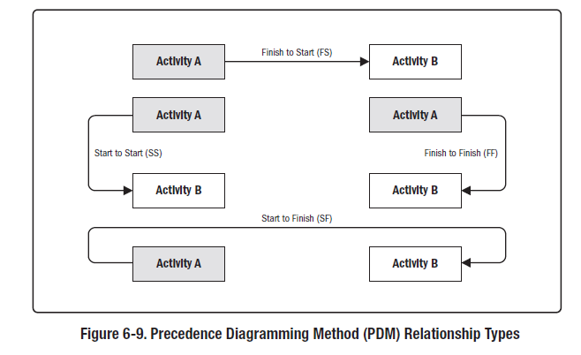
precedence diagram-method

Slide 24
Project phase 3- ‘planning’ - project-baseline “TIME”
Estimation technique – important to anticipate efforts and duration– pg 166-169
Analogue – basis in benchmarking
Three-point → Used when you’re not sure of the duration or due to lack of benchmark or low maturity.
Positive estimation(=PS)
Negative estimation (=NegS)
Normal estimation (=NS) (should be multiplied by 4)
Delphi-method
Fall back on independent estimation experts
Take the average
Combine the three methods ….
Attention points
Environmental impacts
Contingency: should be an average of 15% à 20%
Formula
Estimation = (PS+4xNS+NegS)/6

Slide 25
Project phase 3 - ‘planning’ - project-baseline “cost”
How much should the project costs ? Pg 175 …
Set-up a “cost-baseline” …. !
Resources ➔ man days ➔ day rate
Prices used in RFI /RFP
Renting costs
Cost infrastructure
Cost of delivery
Cost of licenses ….. etc
Also use the estimation techniques as in ‘project baseline “TIME”.
Put focus on COST of Quality
cost of conformance
cost of non-conformance
Look-up

Slide 26
Project phase 3 - ‘planning’ – risk management
Be positive! --- see SWOT-analysis
Negative risk = threat
Positive risk = opportunity

Slide 27
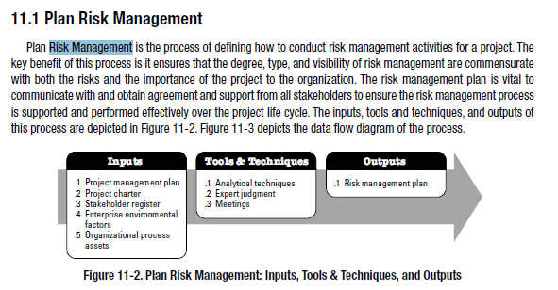
How do we manage risks?

Slide 28
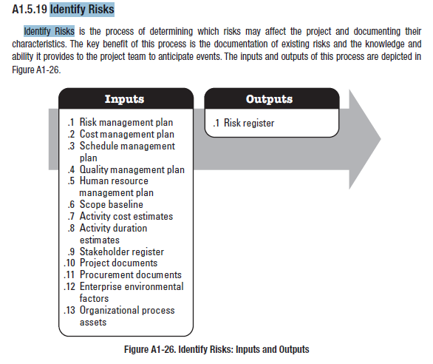

Slide 29
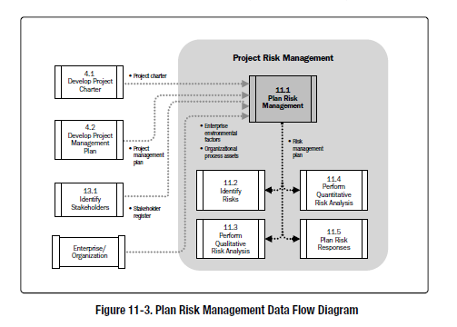

Slide 30
Project phase 3- ‘planning’ - the project-organization
The right people on the right place.
Skill – competence – attitude – location – culture ….
Stakeholders ➔ the do have a lot influence on the project – pg 187-188
Make a stakeholder-analysis
Make a “RACI-chart”
Make a stakeholder register
Governance - to steer
Set-up project structure
Make an overview of the dependencies between all your project participants
Create relational mechanism
Operational meeting – steerco – day2day progress meeting
Build-up a relation with PMO (project management office)
Communication plan (part of Governance) – pg 190

Slide 31
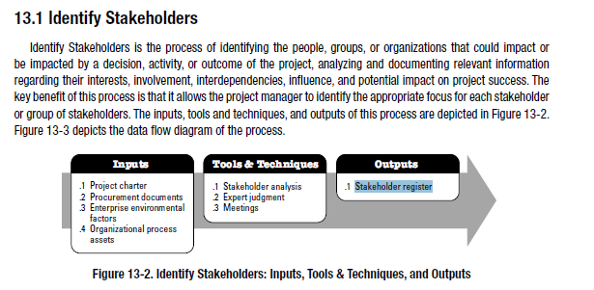
Stakeholder

Slide 32
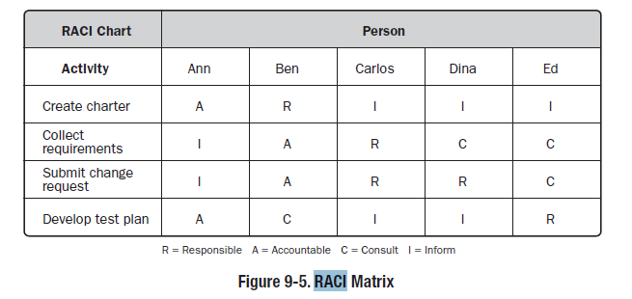
RACI - example

Slide 33
Project phase 3 - ‘planning’ - de project progress
Part of the Governance
Project follow-up mechanism is part-of the WBS – pg 216-…
Create a project dashboard with controls – kpi-s
Daily task to follow-up the progress of the project
Define the controls (should be ideally metrics) in your project documents
Metrics can be symbolized as RAG or smileys
Define the KPI-s with your team members pg 218-219)
Translate the objective in KPI-s – Requirements can also be used …
Subjective follow-up
Objective follow-up
Use the constraints as the reference

Slide 34
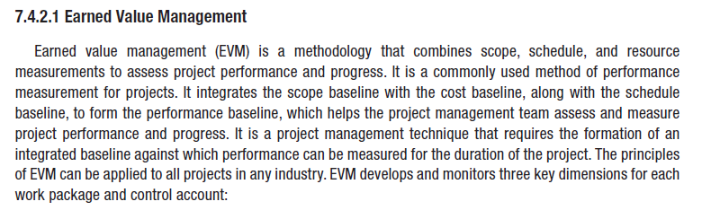
Project phase 3 - ‘planning’ - the project progress

Slide 35
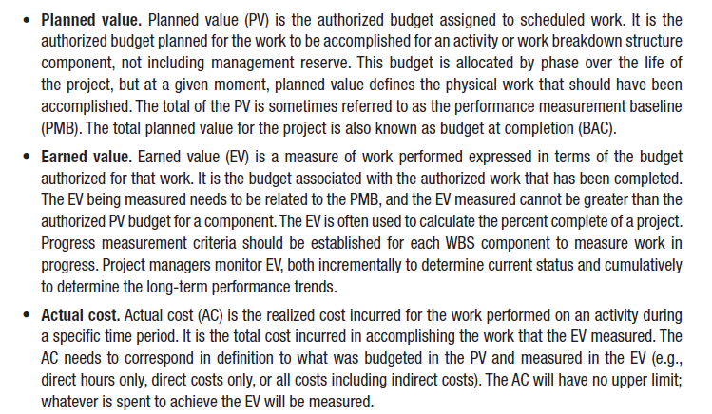
Project phase 3 - ‘planning’ – Most used EV

Slide 36
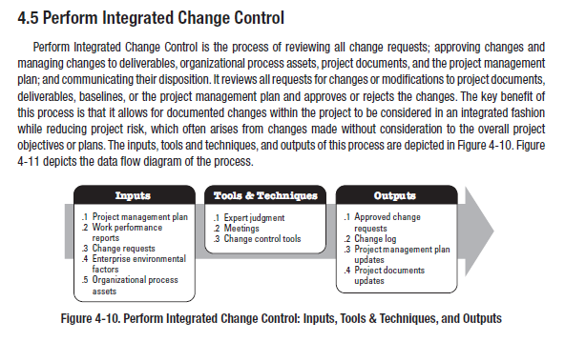

Slide 37
Project phase 4 - ‘the design’
Deliverables of the design phase – pg 85 …
the “Blue-print” = documents
based
‘requirements’
Inventoried processes
Actual and new work methods
6-constraints
How do you build a “Blue-print” ?
Organize workshops per theme – type of deliverable – project area – etc ..
Build a Proof o Concept (=POC) or Pilot
Involve the stakeholders to validate the “Blue-print”
Set-up an approach to build your “Blue-print”
Etc …

Slide 38
Project phase 4 - ‘the design’
Deliverables of a Blue-print
AS-IS …. ➔ … TO BE (basis of the transition-plan)
Processes
Approach
Impact-analysis for the customer ➔ management of change
Functional design
Describe the functional requirements of the customer and their dependencies needed to reach the final objective.
Vb: use-case (pg 91)
Describe the business logic (=process)
Architecture design
… technical – platforms – application landscape -
… sometimes do use a meta-language - see pg 92-93

Slide 39
Project phase 4 - ‘design’
Deliverables van de ontwerp-fase – pg 85 …100
Security scheme : mostly used for e-commerce / Apps / web services ….
Vb: salary – e-commerce – netbanking –
Interfaces + describe their dependencies – important to know for troubleshooting
Link between different objects : ‘data-loss’ is a risk
Interfaces : physical – systems – logical - Master-slave systems
ETL → translation rules
…
Data-migration architecture
Source of data → recipient
Translation rules
When can a translation happen?
Etc…
Test-plan
Assumptions and risks-register

Slide 40
Project phase 5 - ‘implementation’
Deliverables during the implementation-phase – pg 101 … 106
The build ➔ Basis and source of the “Blue-print”
The implementation phase is designed and planned in the first 4 project phases.
Requirement
Concept
Planning
Ontwerp
The implementation phase is designed and planned in the first 4 project phases.

Slide 41
Project phase 6 - Testing (=controls)
pg 101 … 106
The requirements are the basis and the input for any kind of controls
Needs
Expectations
Objectives
IMPORTANT Phase!!!
Do not save time or re-gain time in the test phase
WRONG Decision → Increase project RISK
Actual complexity require to breakdown the solution on test-manageable parts.

Slide 42
Project phase 6 - Testing (=controls)
Test-types – pg 109 … 111
Functional testing
Cross-platform (= compliancy and portability - ..)
Performance testing
User (friendly) testing
Security – DO NOT Forget!
Regression testing – DO NOT Forget!

Slide 43
Project phase 6 - Testing (=controls)
Test-levels – pg 111 … 112
Unit testing
Integration testing --- DO NOT Forget!
System testing
Acceptance testing
End-2-end testing

Slide 44
Project phase 6 - Testing (=controls)
Deliverables during test-phase– pg 112 … 113
Assign a test-manager in your project-organization
Test-plan (=project plan)
Test-scenario + production data should be available on a test-environment
Detect defects and variance towards requirements – objectives ….
Test-environment --- logically / physically isolated from PROD-environment
Test-register +documentation
Log of test results
Categorization of the test (expected) results (major – minor …)
Actions to remediate - mitigate
Test-tools
Test-acceptation plan
see “process requirements” / “WBS”
Basis for the “GO-LIVE”

Slide 45
Project – testing strategy ….
Build-and-fix (pg 118-126)
Customer or end-user helps in testing --- > direct bug fix ….
Reactive method -→ can have a negative impact on customer satisfaction.
Can be part of X-programming / agile programming
Waterfall – sequential method
Once a testing phase is closed – you can't go back
Planning (concept – blue-print) is KEY
To use in small project – do not use in complex project → creates high RISK
Rapid-prototyping
Build a proto-type as a test-platform – can be later on upgraded to the final solution.
Cfr – waterfall
Incremental method → small adjustments increasing control on planning – resources – scope
SCRUM.org
Do use in projects with high complexity
Do break the project in smaller pieces – every piece can be a stand-alone object
Assembly lager pieces to a consistent whole
Release / version management is important

Slide 46
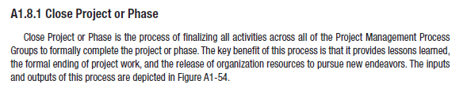
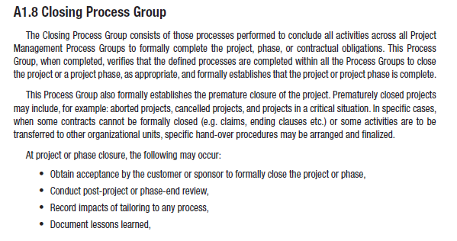
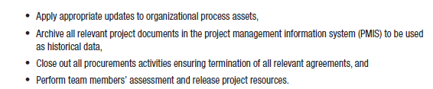

Slide 47
Project phase 7- ‘turnover’ – project closure
Handover to the RUN -- (BUILD to RUN) – pg 235
Formal closure of the project making use of acceptance documents
Closure and validation of all requirements .
A lot of projects are not formally closed due to the fact the stakeholders and project manager did not inventoried the deliverables. Progress meeting will help avoiding loss of deliverables?
How? Pg 236
Determine evaluation criterions during closure per phase and/or deliverables.
Make use of Governance
Determine operational readiness
Functional – organization - support – user acceptance – cut-over – etc …
Integrate Transition phase with deliverables in every project → from Build to RUN
Deliverables:
Documentation – SOP – training – involvement of Service Desk – involvement service Partners …

Slide 48
Project phase 7 – the turnover → transition
Deliverables during the ‘turnover-fase’ – pg 128-133
Set-up a cut-over plan - how – when – involvement by whom… ?
Deliver transition documentation– see input “blue-print”
Technical documentation
Functional documentation
Procedures + RACI
SOP for day2day support
SLA with stakeholders – do not forget the service partners

Slide 49
Project phase 7 – the turnover → transition
Deliverables during the ‘turnover-phase’ – pg 128-133
Training towards the support organization and end-users
Set-up of an operational management framework
see ITIL – guidelines / best practices
Procedures → import for the SQP (service quality plan)
Vb: re-boot / 1st line support
Problem – change – Release management ….
SLA
OLA (operational level agreement) – related to the support organization
Quality insurance
Organize operation model → OLA between support partners
Integrate the ‘turnover’ phase during the requirement phase – IMPORTANT to avoid defects.
Involvement of Stakeholders

Slide 50
Project management les 02 – het leiden van projecten
HoGent Bedrijf en Organisatie
Guy Dekoning
Academiejaar 2016-2017

